Slide 1


Air Ticket Fares Prediction
Vasavi Koonapalli
EH52257
DATA606 – CAPSTONE

Slide 2
Why this project?
Who would not want cheaper fares?
Factors affecting fares?
What role do various factors play?
Notes:
Booking cheap air tickets can vary in terms of hassle, depending on the individual's preferences, resources, and circumstances. Some factors that can affect the hassle of booking cheap air tickets include Research and comparison, getting hold of the correct timing of the travel that is economic, budget and ticket availability. Overall, the hassle of booking cheap air tickets can be reduced by being organized, flexible, and proactive in your approach. By doing research, staying on top of prices and promotions, and being willing to book in advance or make changes to your travel plans, you can increase your chances of finding the best deal on air tickets. Booking relatively cheaper air tickets has always been a thing on mind for me and with this project, I intend on doing this.

Slide 3
How did I gather the data?
Data between 11th February and 31st March 2022.
My Data Source – EaseMyTrip.com
Scraped data using BeautifulSoup and Octoparse Tool
Notes:
When researched, I could not find any API that I could use to scrap data from Easemytrip website. I used python web scraping library - Beautiful Soup to gather data from their website. Also, I used a tool called Octoparse to extract some data aswell. The information was gathered in two parts: one for economy class tickets and one for business class tickets. The site yielded a total of 300261 distinct flight booking options. From February 11th to March 31st, 2022, data was gathered for 50 days. The data source was secondary data obtained from the Ease My Trip website.

Slide 4
What were the initial observations?
300,295 distinct flight observations, with 55 fields.
Datasets merging using Tableau and cleaning using Data Interpreter.
Resulting final dataset’s shape: (300261, 11)
Notes:
When I scraped the dataset, I found that the resulting dataset had 300295 rows and 55 field. First, I used Tableau to join both the datasets for business class and economy class. Then I used Data Interpreter, a tool that Tableau has to offer, to clean the data in an easier and hassle-free way.
The resulting clean dataset had 300261 rows and 11 fields after I dropped a few unwanted ones.

Slide 5
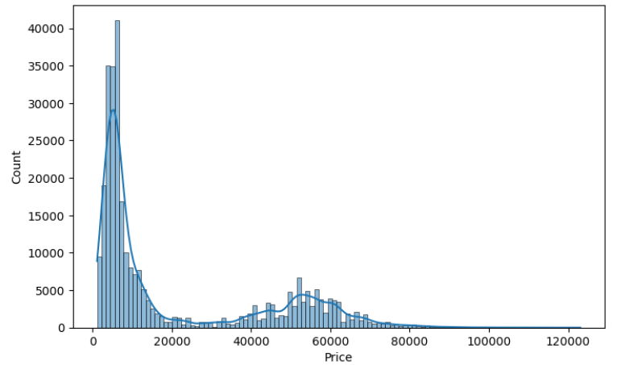
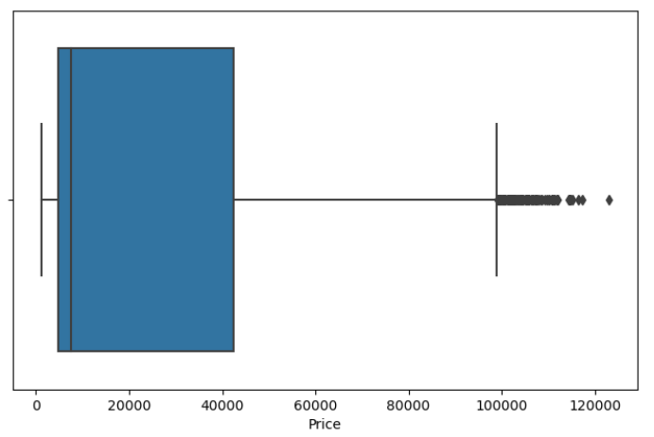
What were the EDA Observations?
Notes:
I used a histplot and boxplot to look the price distribution. The top left corner figure shows us the median and the one on the bottom clearly shows us the mean.
Even though the mean is around 20000, we can see here that the median is approximately 7500. This difference is explainable by the presence of two different tickets: business and economy. On the first graph, we can see that the dispersion seems to be composed by two gaussian curves.

Slide 6
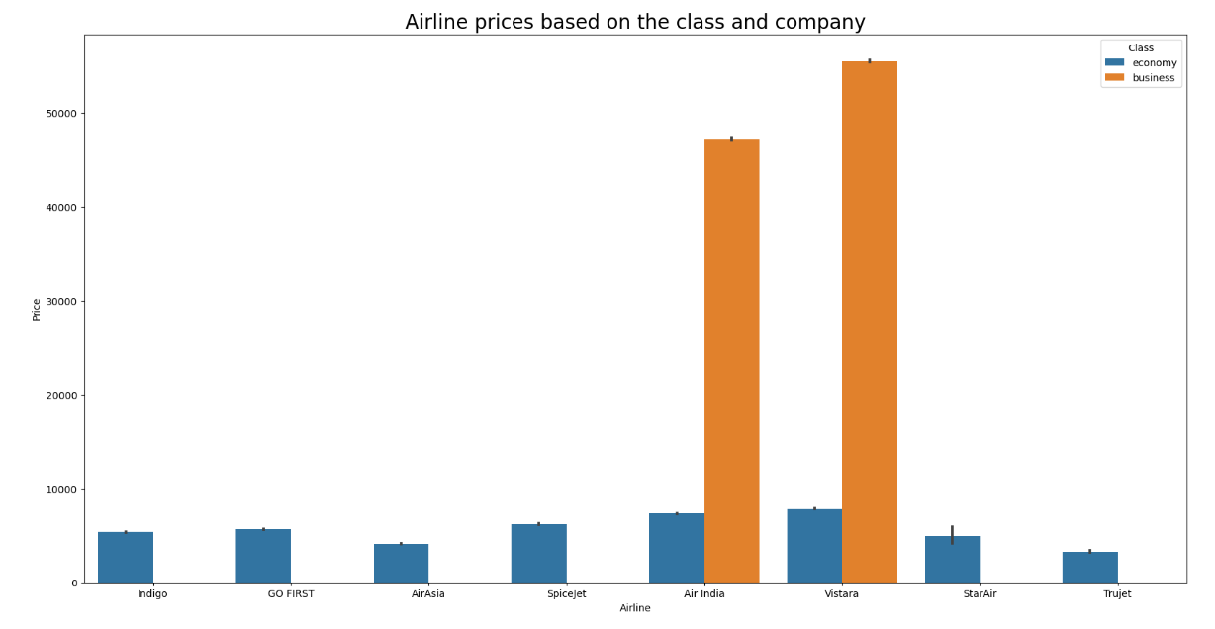
What were the EDA Observations?
Notes:
I wanted to see what the difference would look like between the fares of business and economy class tickets.
Business flights are only available in two companies: Air India and Vistara. Also, there is a big gap between the prices in the two class that reaches almost 5 times the price of Economy for Business tickets.

Slide 7
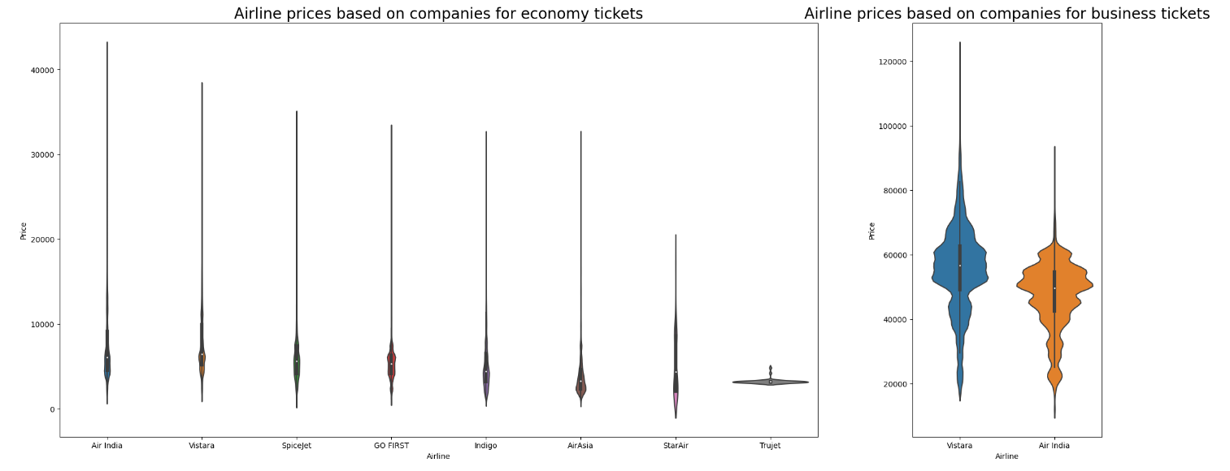
What were the EDA observations? Contd.
Notes:
Here, I plotted two graphs to see if prices varied with airlines.
There are slight differences between each companies on this graph, AirAsia seems to have the cheapest flights when Air India and Vistara are more expensive. However it looks like Vistara's business tickets are a little more expensive than the Air India's ones.

Slide 8
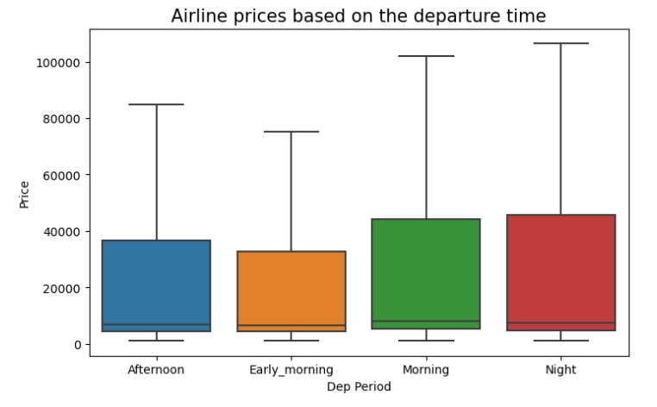
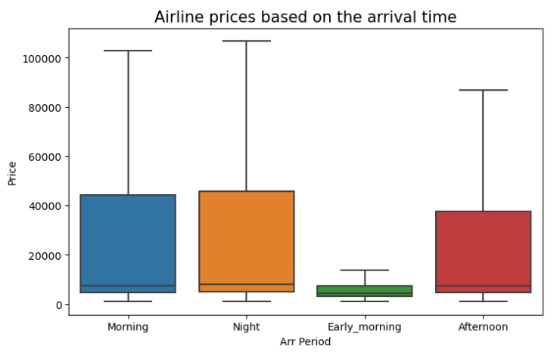
What were the EDA observations? Contd.
Notes:
This slide talks about what time of the day has to do with the ticket prices.
As expected, flights leaving early in the morning remains the cheapest way to travel. But it's also visible that arriving early morning is also cheap and afternoon flight are a bit cheaper than morning and night flights.

Slide 9
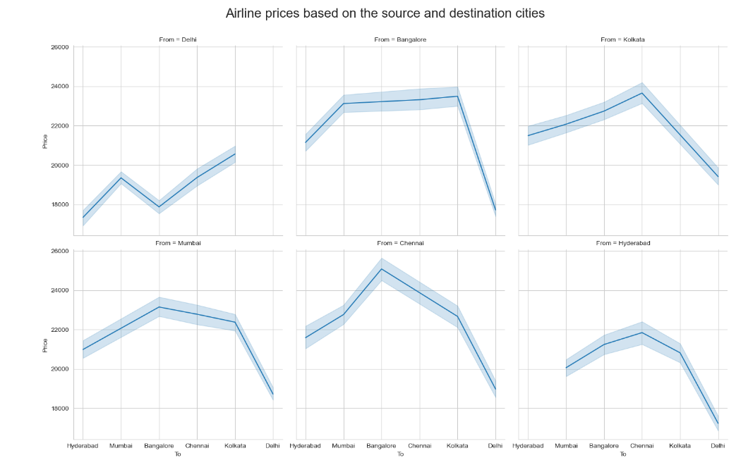
What were the EDA observations? Contd.
Notes:
Then, I wanted to see what destinations and sources were doing to the prices.
On one hand, it seems that flights leaving from Delhi are often cheaper that from other source cities and Delhi is also the cheapest destination to go probably because it is the capital of India, the airport is the biggest and proposes more flights. On the other hand, the prices are more or less similar to and from all the cities.

Slide 10
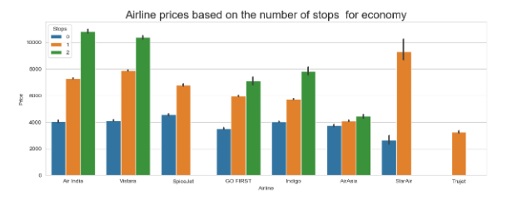
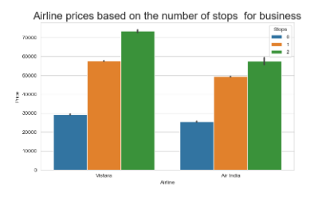
What were the EDA observations? Contd.
Notes:
I always wondered how number of stops would affect the price of the ticket. I plotted these graphs to see what was happening.
It's clear that the more stops there are, the more expensive the flight is, except for AirAsia where the prices seem more constant. The behaviour and different analysis of AirAsia tend to show that it relates to a low cost company.

Slide 11
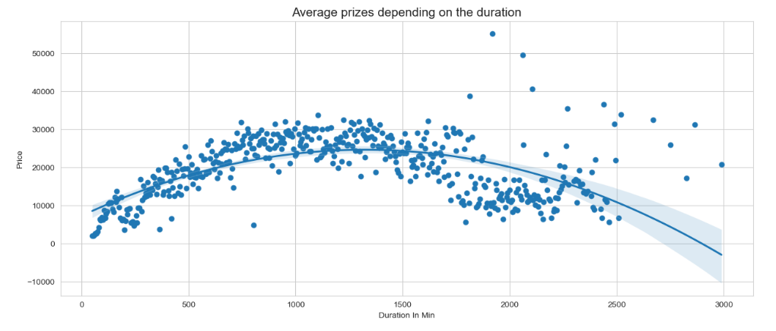
What were the EDA observations? Contd.
Notes:
We all know that the duration of flight has everything to do with the cost of the ticket.
It is clear that here the relationship is not linear but can be approximated with a second degree curve. The prices reaches a high price at a duration of 20 hours before lowering again.
However some outliers seem to affect the regression curve .

Slide 12
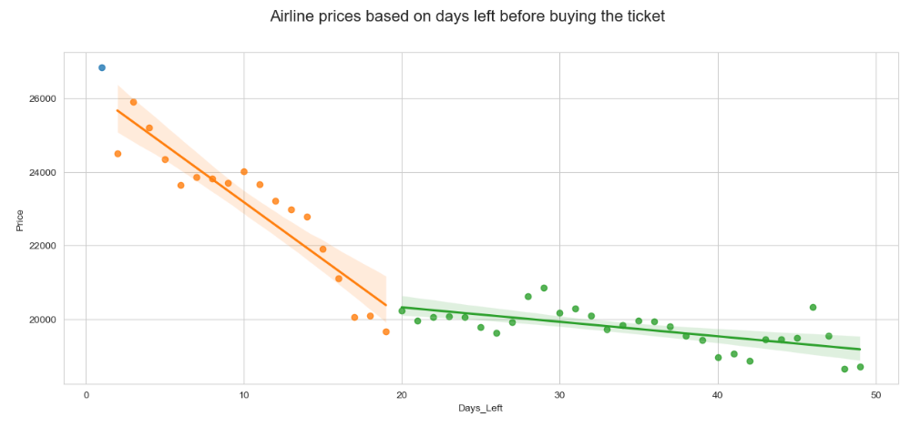
What were the EDA observations? Contd.
Notes:
I then wanted to see how price is varying when I buy the ticket just 1 or 2 days before the departure. The regression graph here shows the graph for this.
It is possible to see two different curves on this graph, the first one, stable between 50 and 20 days before the flight, and a positive monotone curve between 20 and 2 days before.
A pattern is clearly visible in the way prices evolve depending on the days left.
The graph highlights how the prices rise slowly and then drastically start rising 20 days before the flight, but fall just one day before the flight up to three times cheaper. This can be explain by the fact the companies want to fill their empty seats and thus lower the prices of the tickets to ensure the planes remains full.

Slide 13
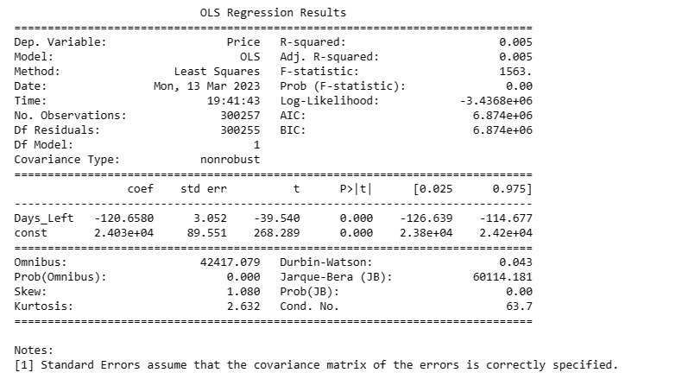
What were the EDA observations? Contd.
Notes:
Price vs Days Left using Linear Regression - OLS Method
To quantify how price varies with change in number of days left, I created a simple linear regression model using OLS method (Ordinary Least Squares Method), with 'price' as dependent variable and 'days_left’ as independent variable.
From the regression summary above we can come to the conclusion that when all other factors remain constant, the ticket price goes up by INR 120 for one day decrease in the flight to take off.

Slide 14
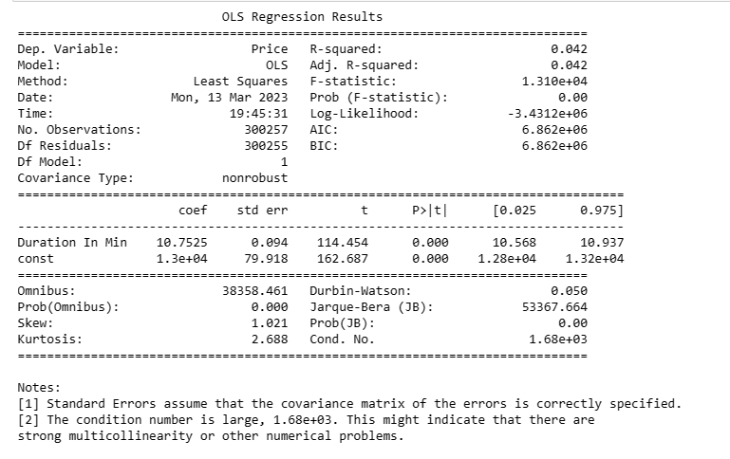
What were the EDA observations? Contd.
Notes:
Price vs Flight Duration using Linear Regression - OLS Method¶
To quantify how price varies with change in duration of the flight, I created a simple linear regression model using OLS method (Ordinary Least Squares Method), with 'price' as dependent variable and 'dur_mins’ as independent variable.
From the regression summary above we can come to the conclusion that when all other factors remain constant, the ticket price goes up by INR 10.7 for one minute increase in the flight duration.

Slide 15
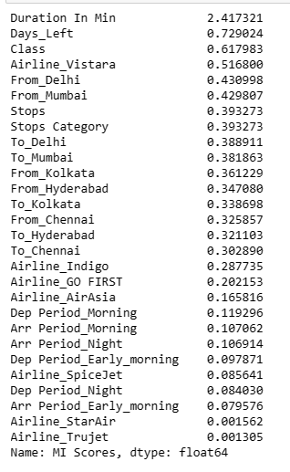
How did I apply ML to solve the problem?
Feature Engineering
Mutual Information for feature
selection.
Notes:
This is where I decided what features I should be using to predict ticket fare.
The correlation is a good metric for linear relationship but doesn't highlight nonlinear ones. For that I will use mutual information.
Mutual information is calculated between two variables and measures the reduction in uncertainty for one variable given a known value of the other variable. A quantity called mutual information measures the amount of information one can obtain from one random variable given another.
The image here shows the results of my mutual information calculation.

Slide 16
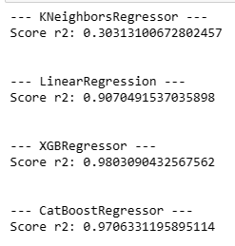
How did I apply ML to solve the problem? Contd.
Notes:
Since my target variable here is a numerical value, I decided to use regression models to predict the ticket fares. Here I used KNNRegressor, Linear Regression, XGBRegression and Catboostregressor. From the above results, it can be seen that XGBRegressor was giving me extraordinary results, followed by Linear Regressor.

Slide 17
What did I do to improve the accuracy?
STACKING AND BLENDING
Notes:
Like we saw in the previous slide, It seems that best results are given by the XGBRegressor. This may be explained by the fact some relationships are not linear like the duration or the days_left. Thus, a more flexible algorithm like XGBRegressor tends to give better results. For this, I used a technique called stacking and bending.
In the essence, stacking makes prediction by using a meta-model trained from a pool of base models — the base models are first trained using training data and asked to give their prediction; a different meta model is then trained to use the outputs from base models to give the final prediction. The process is actually quite simple. To train a base model, K-fold cross validation technique is used.
Blending is very similar to Stacking. It also uses base models to provide base predictions as new features and a new meta model is trained on the new features that gives the final prediction. The only difference is that training of the meta-model is applied on a separate holdout set (e.g 10% of train_data)rather on full and folded training set.
The first layers will composed with all the different regressor functions. And the final layer will be XGBRegressor since it gave the best results.

Slide 18
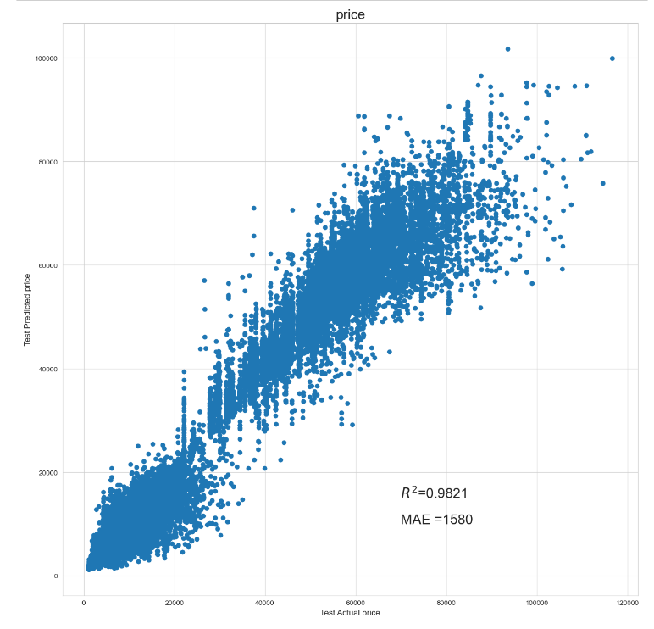
Results for the best model
Notes:
Mean absolute error

Slide 19
Takeaways
What did I learn from this project?
Notes:
Takeaway Points
1. The model that gives the best result is the XGBRegressor with on the test dataset an R^2 score equals to 0.9807 and a MAE score equals to 1688. However when we use the stacking and bending method, we can reduce the MAE by more than 7% with 1580 and increase the R^2 score to 0.9821.
2. There is a big gap between flight tickets in business and economy. In average business tickets are 6.5 times more expensive than economy tickets.
3. Vistara and AirIndia seems to be the most expensive companies and AirAsia the cheapest. However for business tickets, only Vistara and AirIndia are available, and Vistara is slightly more expensive.
4. In general, prices rise quite slowly until 20 days before the flight where the prices rise drastically. But one day before the flight, there usually are empty seats that have not been sold. Thus it is possible to find tickets three times cheaper than the day before.
5. The longer the flight is the more expensive the tickets are until it reaches around 20 hours, then the prices tend to decrease.
6. For the time of the flight:
It seems that departure during early morning is cheaper, and night more expensive.
It seems that arrival during the early morning is cheaper.
7. In general, the more stops there are, the more expensive the flight ticket is

Slide 20
Thank you all!
CONGRATULATIONS ON YOUR GRADUATION, TO MOST OF YOU!
AND ALL THE BEST!

